Slide 1
Secure Data Hiding in Image Using Steganography
CAPSTONE PROJECT
Presented By: Syed Moin Uddin Ayaz
Student Name : Syed Moin Uddin Ayaz
College Name & Department : Siddhartha Degree College

Slide 2
OUTLINE
Problem Statement
Technology used
Wow factor
End users
Result
Conclusion
Git-hub Link
Future scope

Slide 3
Problem Statement
In the modern digital age, it is a major challenge to keep sensitive data secure. Normal encryption techniques are easily detectable, and hence the data becomes a target. Steganography is employed in this project to conceal data within images, and thus it remains safe without being detected. The aim is to develop an easy and efficient means of transmitting secret data securely.

Slide 4
Technology used
This project is developed in Python and depends on libraries such as OpenCV for image processing and NumPy for data handling. It also employs cryptography libraries to provide added security. The development platform is Jupyter Notebook or any IDE supported by Python.

Slide 5
Wow factors
What is special about this project is that it can hide information in images but not distort the image much, which means detection becomes very hard. It increases security by applying powerful encryption beforehand and then hiding the data, providing an added later of security. The method is quick, easy, and supports various image formats, which means it is more efficient and easier to use than most other steganography methods.

Slide 6
End users
This project is beneficial for cybersecurity experts, journalists, and activists who have to transmit sensitive data securely. Government agencies and intelligence services can also employ it for secret communication. People concerned with privacy can also employ this technique to safeguard personal information from unauthorized use.

Slide 7
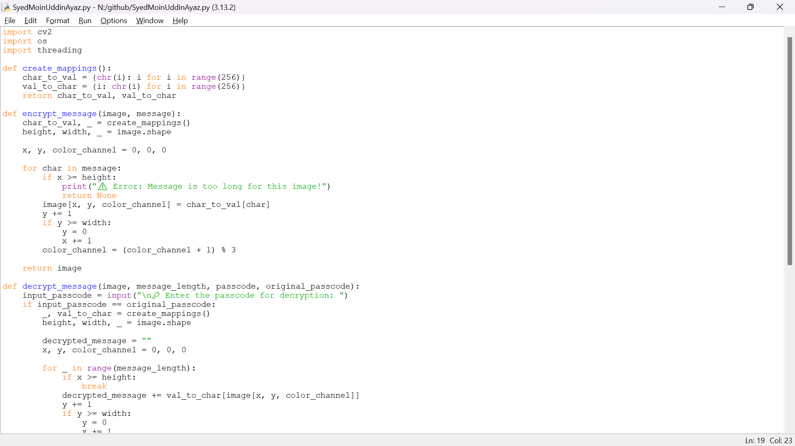
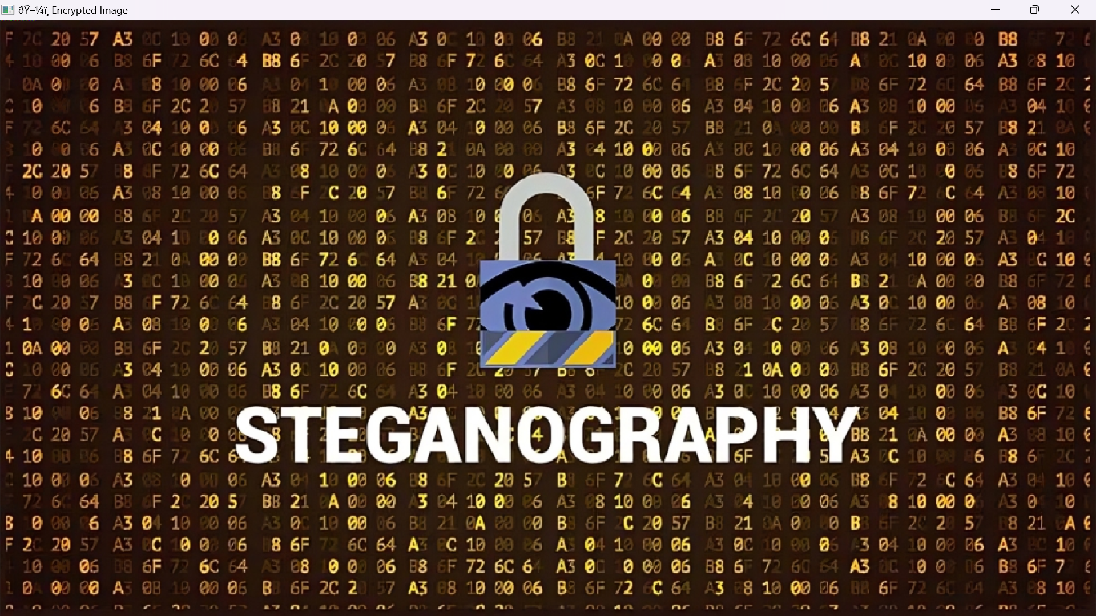
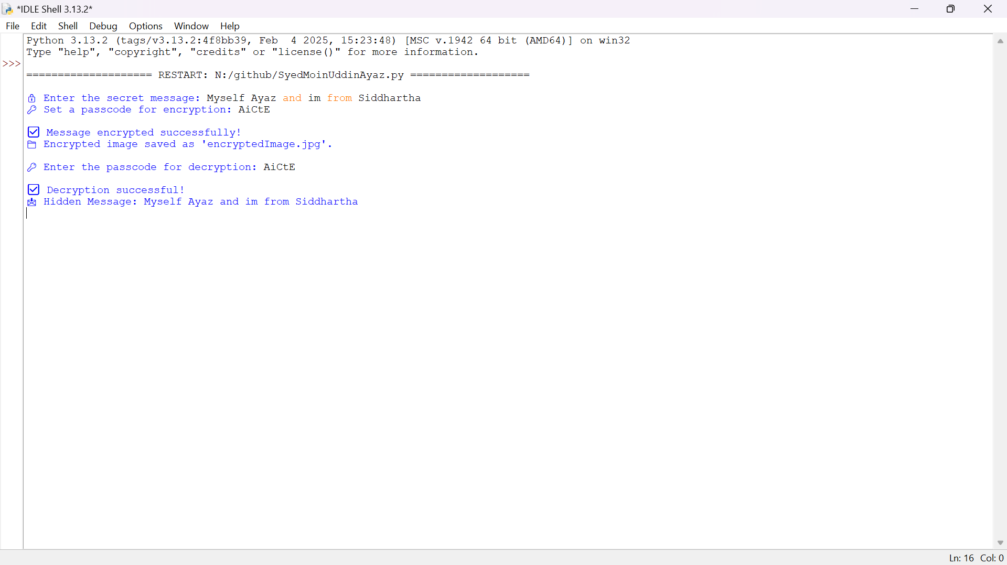
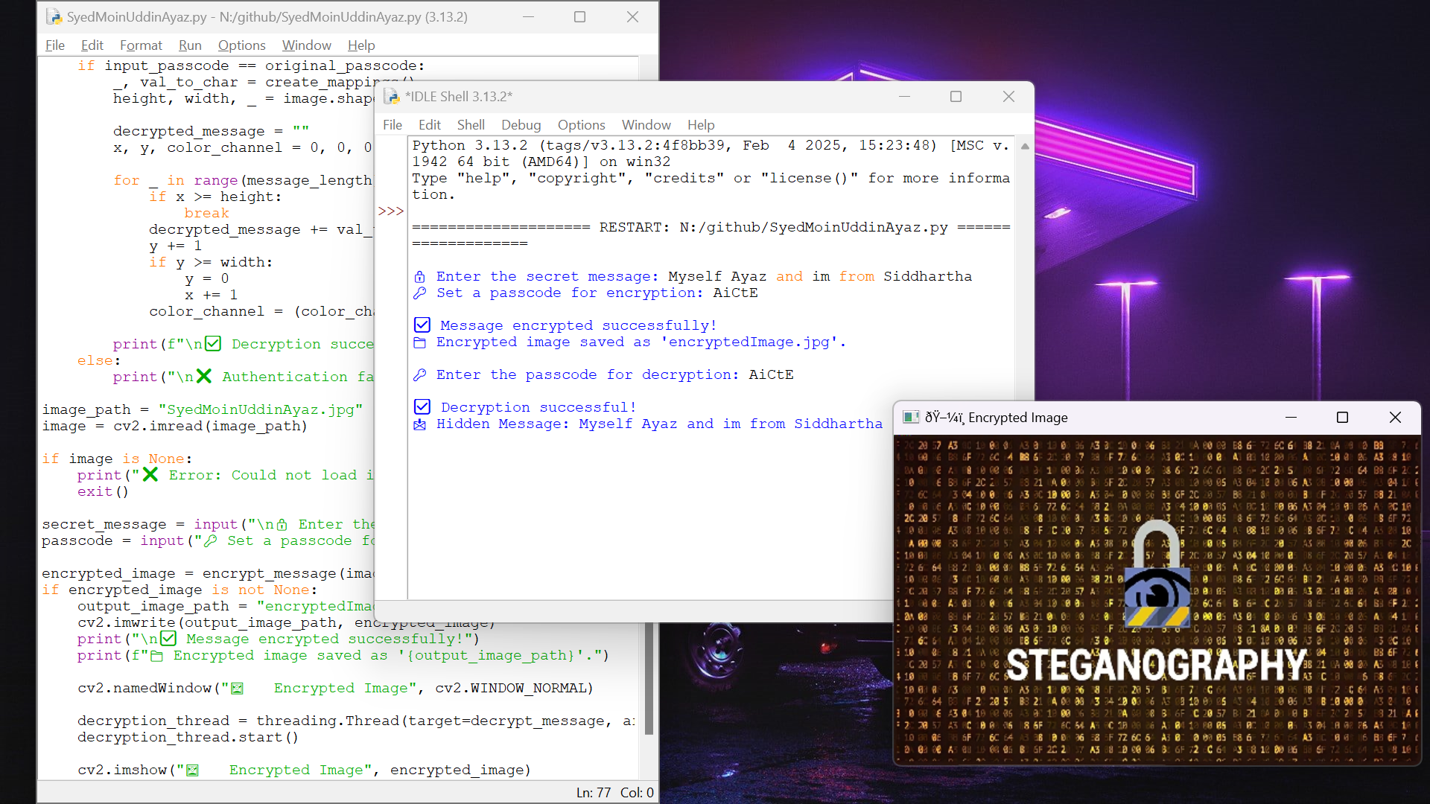
Results

Slide 8
Conclusion
In the future, the project can be upgraded by adding sophisticated encryption methods to enhance security. It can also be modified to include video and audio steganography for greater versatility. Moreover, an AI-powered detection system can be added to ensure that concealed data is not detectable by steganalysis tools. A friendly application or web interface can also be created to simplify the process for non-technical users.

Slide 9
GitHub Link
https://github.com/SyedAyaz7k/Steganography.git

Slide 10
Future scope
This project is an easy yet efficient method to conceal sensitive data within images through steganography.The concealed data remains safe and nearly undetectable while maintaining the quality of the image. With encryption, it provides an added layer of security, making it even more secure. This process can be applied to secret communication, cybersecurity, and safeguarding valuable information from being accessed by unauthorized persons. It's generally a smart and pragmatic means to transmit secret messages without arousing suspicion.

Slide 11
THANK YOU

